Slide 1
PERSONAL PORTFOLIO
SUBMITTED BY
MD. EVAN KHAN EMON
UG02-47-18-009
DEPARTMENT OF CSE
SUBMITTED TO
KHAN MD. HASIB
LECTURE DEPARTMENT OF CSE
COURSE CODE : CSE – 0402
COURSE NAME : E-Commerce Lab
STATE UNIVERSITY OF BANGLADESH

Slide 2
OUTLINE
INTRODUCTION
PURPOSE
HOW TO DEVELOP A PERSONAL PORTFOLIO
OVERVIEW OF PROJECT
REQUIREMENTS TOOLS
ER DIAGRAM
ADVANTAGES
DISADVANTAGES
CONCLUSION

Slide 3
INTRODUCTION
A personal portfolio is an organized collection of documents that show your successes both in and out of. It will contain documents that show your goals, skills, interests, and experiences. This work aims to report the process of designing and developing a web portfolio for a graduating bachelor design student specializing in web design and development. It will deﬁne what a portfolio website is, it will also explain the basic theory and elements of an online portfolio design process. Further this work presents different ways and channels through which a design student can create and develop a personal online portfolio. By covering aspects such as: how to integrate personal visual identity and what is required to build an effective portfolio. In simple words, a web portfolio3 is a 24 hours working showcase of the designer’s works, professional skills. periences, values and achievements. The personal information that you incorporate into your portfolio can greatly reflect on your abilities as an individual as well as become a useful tool in marketing yourself to employers, corporations, colleges and universities.

Slide 4
Purpose
Creating a personal portfolio is a great idea for several reasons:
You will have an organized record of your goals, skills, and achievements.
You will have an impressive document (about you) to take to an employment interview.
You will be able to share your portfolio with different education programs.
Portfolios may be helpful when applying for a scholarship or bursary.
Teachers and advisors will be able to easily see who you are.

Slide 5
How to Develop a Personal Portfolio
There are four stages to creating and maintaining a personal portfolio:
ONE: Collect and create information and records that show your goals, interests, skills, and achievements.
TWO: Divide your portfolio material into logical sections so it is easy to read.
THREE: Review your portfolio to make sure it shows you in the best possible light
FOUR: Maintain your portfolio by regularly adding new material that reflects your new skills and experiences.

Slide 6
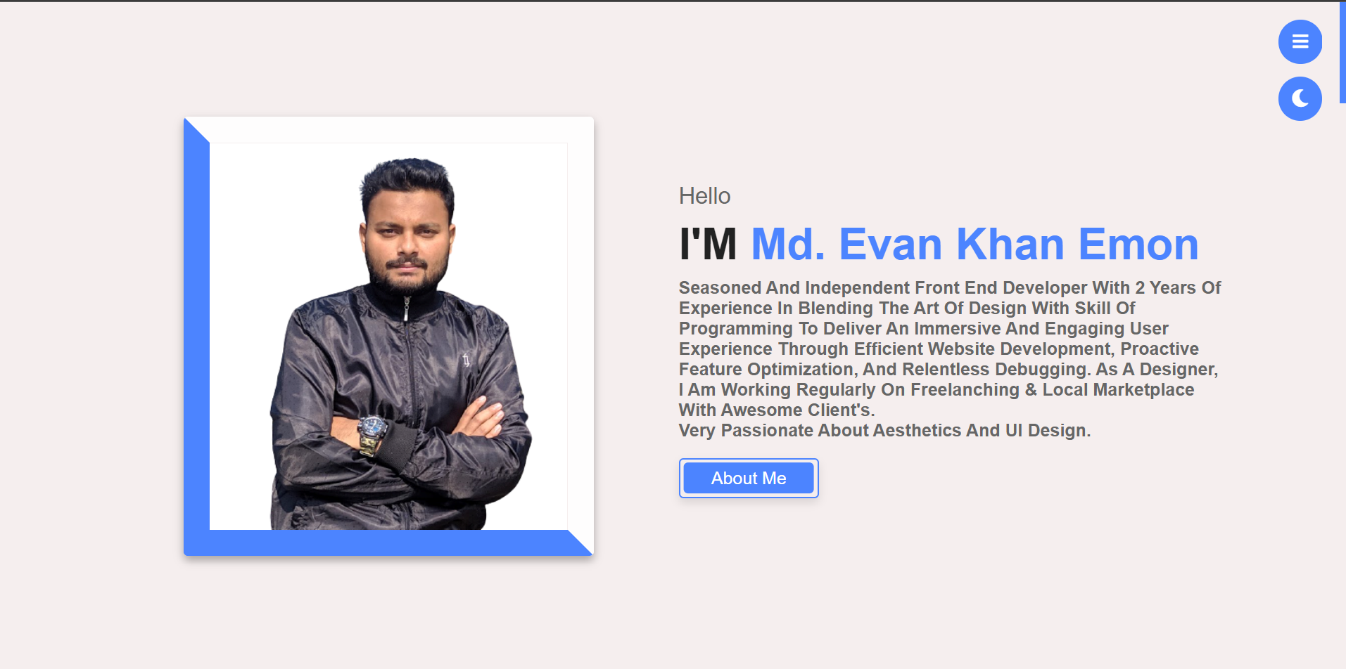
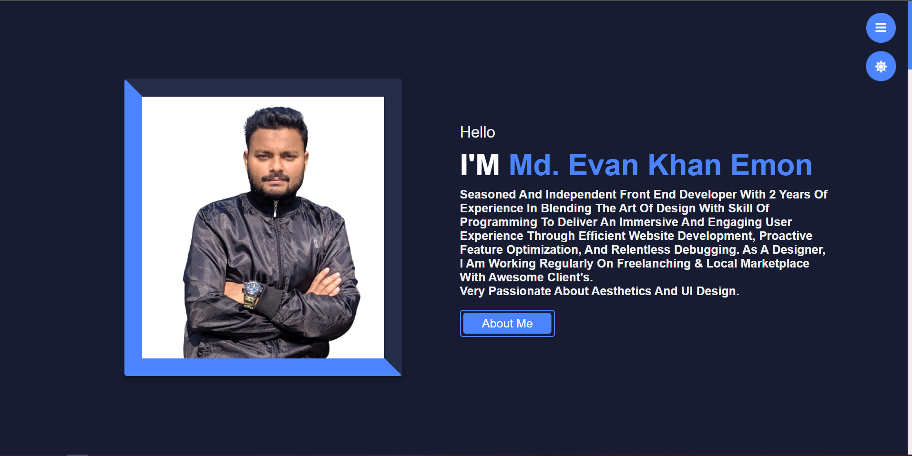
OVERVIEW OF PROJECT

Slide 7
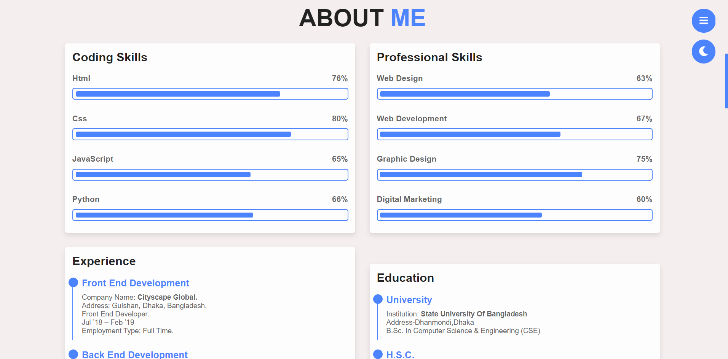
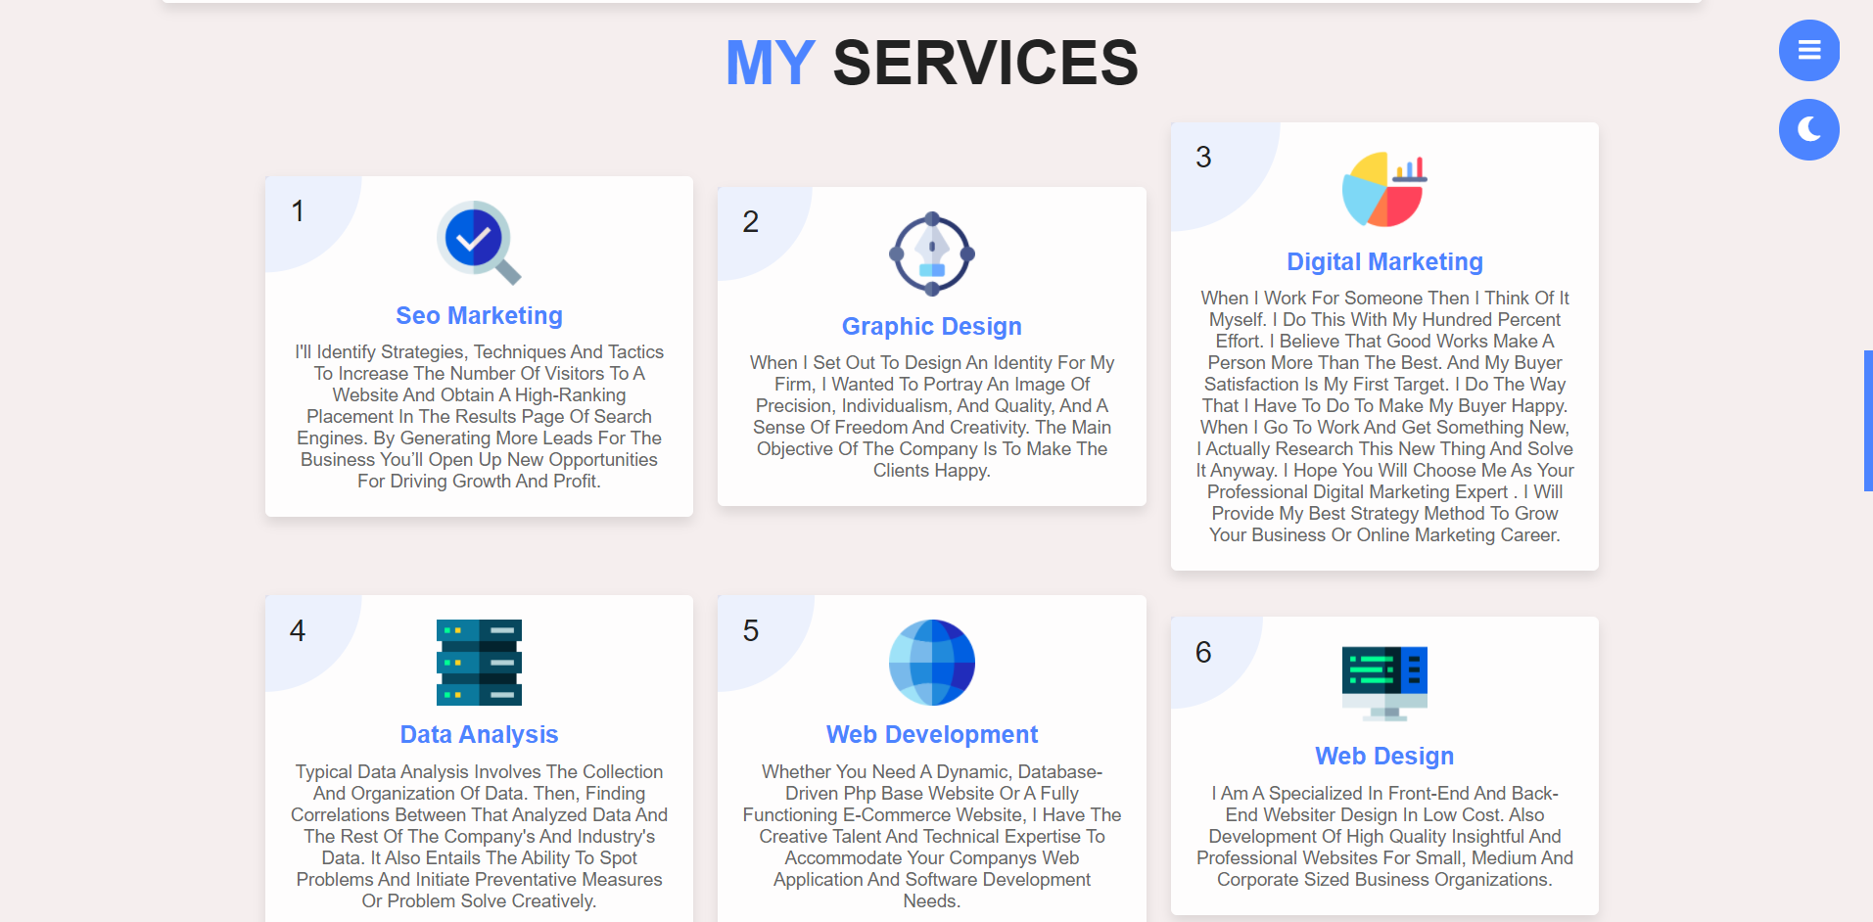
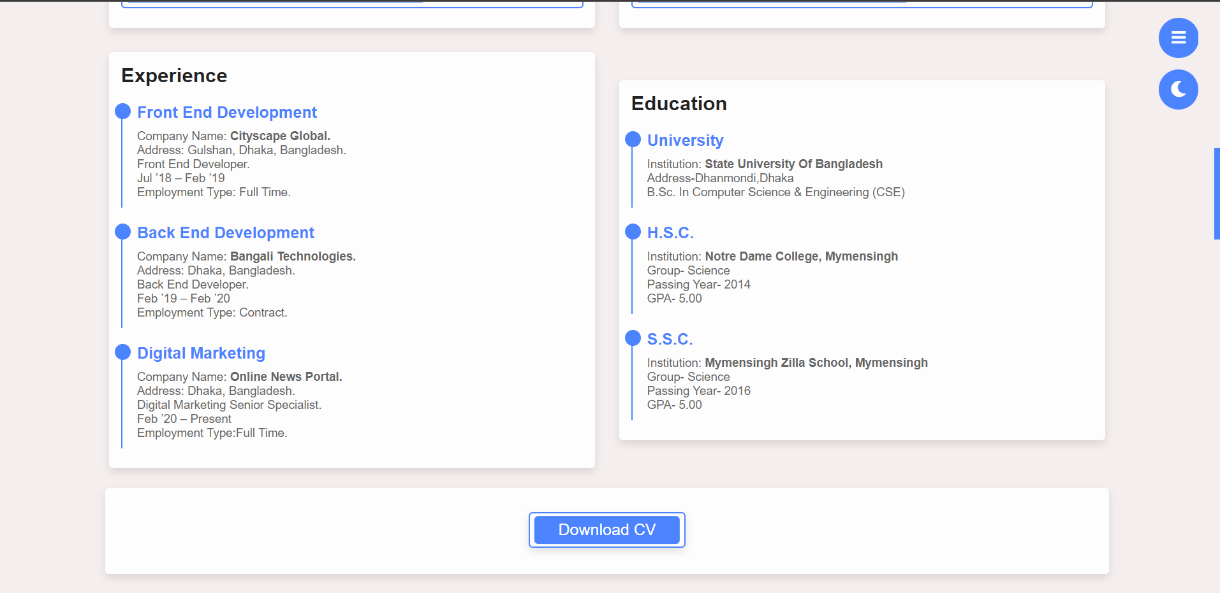
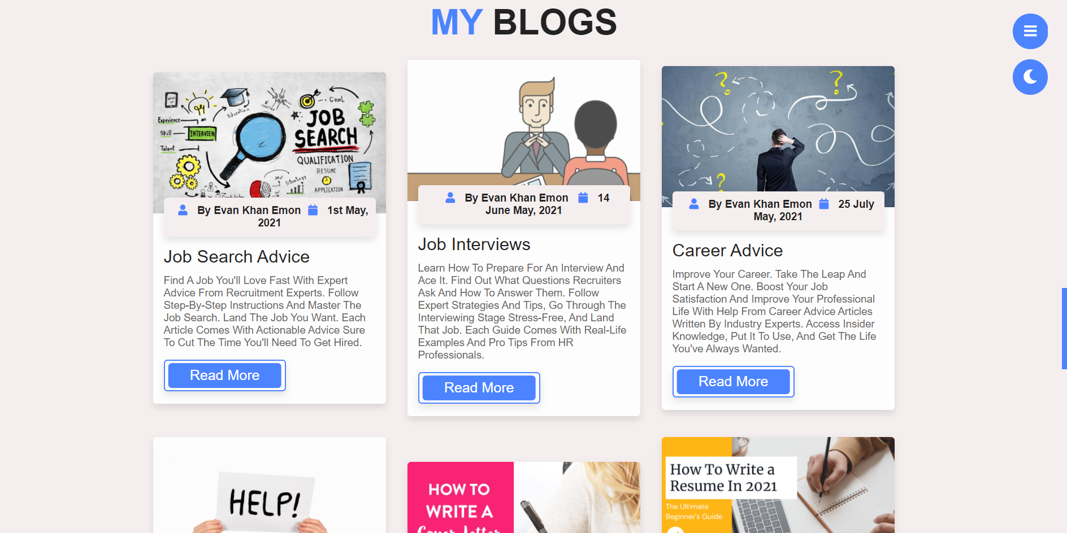

Slide 8
REQUIREMENTS TOOLS
CSS
JS
HTML
XAMPP
VISUAL STUDIO CODE

Slide 9
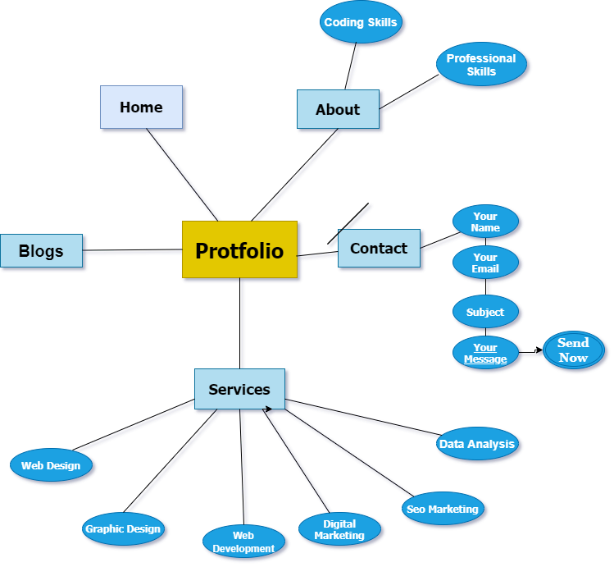
ER DIAGRAM

Slide 10
ADVANTAGES
PROFESSIONAL WAY TO SHOWCASE OUR WORK.
GOOD FOR FUTURE CLIENTS & POTENTIAL EMPLOYERS.
INCREASES OUR VISIBILITY AND ONLINE PRESENCE.
REFLECTS OUR PERSONALITY & CREATIVITY.
FLEXIBILITY.

Slide 11
DISADVANTAGES
MARKET RISK
BELOW AVERAGE RETURNS
TOO COMPLICATED
INDEXING

Slide 12
CONCLUSION
Personal portfolio should change as learn and develop new skills. Regularly update portfolio by getting rid of old information and inserting new and better evidence of our goals and skills. Remember, portfolio is a great way to introduce yourself to a potential employer or students. It is something that may come in handy now and in years to come. Update it regularly. Be proud of your achievements!
End the essay on a positive note.
Communicate the importance of your ideas and the subject matter.
Provide the reader with a sense of closure.
Revolve and summarize your main points.
Rephrase and then restate your thesis statement.

Slide 13


